Slide 1

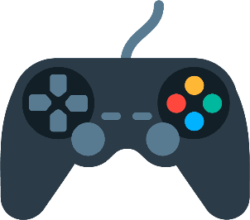
BESETO 2022
Review of CBT Programs on Gaming/Internet Use Disorder
: Focusing on CBT Techniques used
Seoul National University Hospital
Clinical & Research Fellow in Addiction
Seon Young Park
Notes:
Hello,
I’m Seon Young Park, from SNUH, South Korea.
Today I’m going to present my review about CBT Programs on gaming disorder and internet use disorder.
This systematic review, mainly focused on CBT techniques used in program.

Slide 2

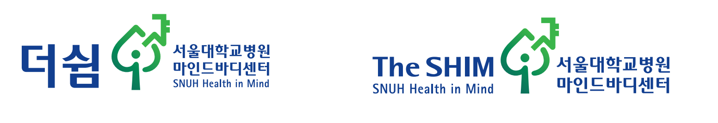
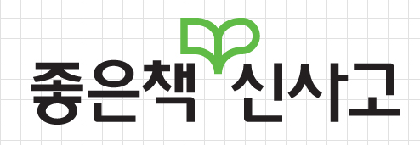
The SHIM center
The SHIM
더 쉼 (더 = more, 쉼 = rest)
SNUH Health In Mind
Non-pharmaceutical, Psycho-Social
Intervention in Psychiatry
Project is donated by Sinsago
Publisher
Textbook, books for kids & adolescents
Notes:
I started research on IUD/GD CBT, because my hospital organized a center for non-pharmaceutical, psycho-social intervention in psychiatry.
The center is named as ‘the SHIM’, which is an abbreviation for SNUH Health In Mind. And also ‘the’ means ‘more’ and ‘shim’ means ‘rest in Korean. So it means ‘more rest’ to patients.
The project is donated by Korean Publisher ‘Sinsago’. They make textbooks, books for kids & adolescents.

Slide 3
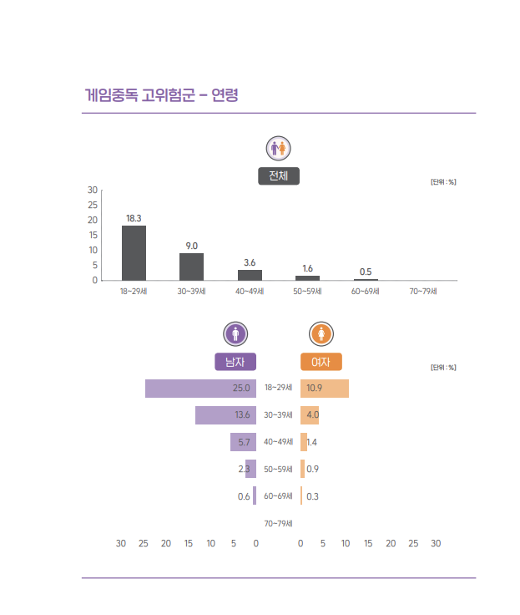
Introduction - Background
Growth of IT and gaming industry
Internet addiction & gaming disorder became serious mental health issues.
High risks of IGD in Korea (by Gender)
High risks of IGD in Korea (by Age)
Notes:
Now, Let’s start about my study.
As you all know, due to growth of IT and gaming industry, internet addiction and gaming disorder became serious mental health issues globally.
This graph is a epidemiologic study about IGD in Korea. About 20% of adolescents are high-risk of IGD. Especially boys, high-risk adolescents were about 25%.
It’s really serious, especially east Asian countries like Korea.

Slide 4
Introduction – Research Question
Cognitive Behavior Therapy
Widely used
Effectiveness in both prevention and treatment
Chang et al. (2022)
Stevens et al. (2019)
Programs were diverse among study groups.
Study Aim
Review contents and CBT techniques reported in studies
Notes:
For the prevention and treatment of IUD/GD, CBT is widely used.
Many systematic reviews and meta-analysis showed effectiveness of CBT in both prevention and treatment.
However, the CBT programs done by each study groups were very diverse.
I was interested about developing programs for Korean adolescents,
However the programs were too diverse, so I wondered how to make programs.
So first of all, I reviewed CBT programs of previously published studies, and compared them.
This study was aim to review contents and CBT techniques reported in previous studies.

Slide 5
Method
Database Search
6 Database
Ovid medline, EMBASE, Cochrane Library, CINAHL, PsycINFO, World of Science
Librarian in SNU College of Medicine library
Keyword
Internet, game, SNS, computer, smartphone addiction/disorder/use disorder
Cognitive Behavioral Therapy
Notes:
This is study method.
Database search was done in 6 database, Ovid medline, EMBASE, Cochrane Library, CINAHL, PsycINFO, World of Science.
Professional librarian in SNU College of Medicine library helped us to find keywords and make search logics.
Our keyword included terms Internet, game, SNS, computer, smartphone addiction/disorder and Cognitive Behavioral Therapy as an intervention.

Slide 6
DB | Search | Search Terms and Logic | n
ovid medline | 1 | exp Internet Addiction Disorder/ | 550
 | 2 | ((cellphone or Smartphone or mobile phone or Application) adj3 (addic* or problem* or disorder*)).ab,ti. | 3,885
 | 3 | ((instagram or twitter or youtube or facebook or Social Networking or Social Media) adj3 (addic* or problem* or disorder*)).ab,ti. | 618
 | 4 | ((game* or gaming or video* or computer* or internet*) adj3 (addic* or problem* or disorder*)).ab,ti. | 6,278
 | 5 | 1 or 2 or 3 or 4 | 10,511
 | 6 | exp Cognitive Behavioral Therapy/ | 34,107
 | 7 | ((Therap* or Psychotherap* or treatment* or intervention* or training or program*) adj3 (psychosocial or cognitivebehavioral or Cognition or Cognitive)).ab,ti. | 57,736
 | 8 | ((behavio* or therap*) adj3 (self adj (control or evaluat* or monitor*))).ab,ti. | 1,123
 | 9 | (behavio* adj3 (contracting or modif*)).ab,ti. | 14,325
 | 10 | (behavio* adj3 (contracting or modif* or activation* or counsel* or intervention or train* or treatment* or therap* or psychotherap* or experiment*)).ab,ti. | 91,312
 | 11 | psycho‐educat*.ab,ti. | 6,194
 | 12 | ((therap* or skill or training) adj3 (Social skill* or assertiveness or problem solving or Relaxation)).ab,ti. | 6,058
 | 13 | guided discover*.ab,ti. | 247
 | 14 | cognitive reconstructur*.ab,ti. | 1
 | 15 | thought record*.ab,ti. | 25
 | 16 | emotional regulat*.ab,ti. | 2,567
 | 17 | 6 or 7 or 8 or 9 or 10 or 11 or 12 or 13 or 14 or 15 or 16 | 149,345
 | 18 | 5 and 17 | 467
Notes:
Details of search terms and logics are shown here.
This one is for ovid medline, and we made similar but little different search logic for different databases.

Slide 7
Method
Study selection
2 psychiatrist (PSY & PSH) reviewed independently
Inclusion
Problem: IUD, GD, PSU
excluded studies mainly focused on anxiety, depression, ADHD, SUD, gambling patients, etc.
Intervention: CBT
Excluded DBT, MET, Mindfulness, counselling, psychotherapy, music therapy, etc.
Notes:
2 psychiatrist, me and another Dr. Park (he is not a family member of mine) reviewed article and selected articles. We reviewed titles and abstracts of articles.
Inclusion criteria was like this.
Problem/Participants were IUD, GD, problematic smartphone use.
We excluded studies mainly focused on anxiety, depression, ADHD, SUD, gambling patients, and so on.
Intervention was CBT.
We excluded studies mainly focused on DBT, MET, Mindfulness, counselling, psychotherapy, music therapy, and so on.

Slide 8
Total (n=4860)
(Ovid 465, EMBASE 387, Cochran 1842, CINAHL 372, PsychINFO 568, Wos 1,226)
Excluded (n=4584)
Mainly focus on other disorders (e.g. anxiety, depression, obesity, autism, SUD, gambling, etc.)
Duplicates (not eliminated by Endnote program)
Not an intervention study (e.g.: psychological characteristics of gamers, neural circuit, EEG etc.)
GD/IUD/PSU Intervention (n=276)
Online intervention (n=15)
Non-CBT psychological intervention (n=47)
(ACT, DBT, CBI, MI, Mindfulness, family therapy, psychodrama, psychotherapy, counselling, exercise, only BM, cognitive bias modification etc.)
Camp-based intervention (n=6)
Pharmacological intervention (n=6)
Multimodal therapy (n=9)
Targets parents & teachers (n=6)
Review article (n=103)
Abstract & Comment (n=12)
Clinical trial protocol (n=26)
Different outcome (n=10)
Case study & Series (n=8)
Other language, Anavailable (n=6)
CBT intervention (n=22)
RCT (n=14)
Single arm trial (n=8)
Notes:
Here is flowchart for study selection.
Total 4860 articles were identified by search logic.
We excluded irrelevant studies, which mainly focus on other disorders, and not an intervention studies.
Among 276 articles, we excluded interventions not mainly focus on CBT, such as ACT, DBD, CBI, MI. camp based, or online intervention were excluded. Review articles, protocols, abstracts were excluded.
Languages written in other languages and unavailable for full texts were excluded.
Finally, 14 RCTs and 8 single-arm trials were included

Slide 9
Method
CBT program review
Main text of the article or supplementary materials
2 psychiatrists (PSY&PSH) reviewed independently and discussed about mismatch
Identify and categorize CBT techniques used
Cognitive therapy | Behavioral Therapy
Psycho-education Cognitive reconstruction Thought Record Behavioral experiment | Self-monitoring Behavior activation Exposure Contingency management (Stimulus control) Emotional Regulation Problem solving training
Notes:
2 psychiatrists read full texts of article and supplementary materials, and identified CBT programs.
We independently reviewed CBT programs, and categorized in category like this.
If we had an mismatch, we discussed and came to an agreement.
Cognitive therapy techniques included
Psycho-education
Cognitive reconstruction
Thought Record
Behavioral experiment
And behavior therapy techniques included
Self-monitoring
Behavior activation
Exposure
Contingency management
(Stimulus control)
Emotional Regulation
Problem solving training

Slide 10
Results
Studies included – RCT (14)
Author (year) | Focus | Participant | Session no. | Session time
Yang (2022) | treatment* | young adult | 5 | 90
Lindenberg (2022) | preventive | adolescent | 4 | 90
Bagatarhan (2022) | preventive | adolescent | 8 | 90
Agbaria (2022) | treatment* | adolescent | 12 | 90
Ede (2021) | treatment | young adult | 8 | 40
Alavi (2021) | treatment | young adult | 15 | 90
Lu (2020) | treatment | young adult | 24 | 90
Kurlala (2020) | treatment | adolescent | 10 | 180
Han (2020) | treatment | adult | 14 | 90
Notes:
Selected studies were shown here.
14 RCT studies were identified.
CBT focus, participants, number of sessions and session time is also shown here.

Slide 11
Results
Studies included – RCT (14) (cont.)
Author (year) | Focus | Participant | Session no. | Session time
Wolfing (2019) | treatment | adolescent+adult | 15 | 100
Torres-Rodriguez (2018) | treatment | adolescent | 22(5) | 45
Lan (2018) | treatment | young adult | 8 | 60
Du (2010) | treatment | adolescent | 8 | 90-120
Notes:
Continuation for RCT studies.

Slide 12
Results
Studies included – Single arm trial
Author (year) | Focus | Participant | Session no. | Session time
Szaz-Janocha(2020) | treatment | adolescent | 4 | 100
Kim(2018) | treatment | adolescent | 8? | 120
Ke(2018) | treatment* | adolescent | 8 | 90
Ke(2017) | preventive | adolescent | 8 | 90
Anuradha(2018) | treatment | adolescent+adult | 12 | N/A
Santos(2016) | treatment | adolescent+adult | 10 | N/A
Wolfing(2014) | treatment | adult | 15 | 100
Young(2013) | treatment | adult | 12 | N/A
Notes:
8 single arm trial studies were identified.

Slide 13
Results
Focus
Treatment (19) > Prevention (3)
Participants
Adolescents (10), College students (5), Adults (6), All (3)
Session no.
Mean [SD] = 10.9 [5.11]
Minimum 4, Maximum 24
Mode = 8
Session time (min.)
Mean [SD] = 93.1 [29.3]
Minimum 40, Maximum 180
Mode = 90
Notes:
In summary,
For the focus of study, 19 studies focused on treatment of IGD, but 3 studies focused on prevention.
10 studies only included adolescents as pariticpants. 5 studies included only college studens, 6 studies included adults, 3 studies included both adolescents and adults.
Mean no. of sessions was 10.9
Minimum 4 to maximum 24 times.
Mode was 8 times.
Mean session time was 93.1 minutes.
Minium 40 min to maximum 3 hours.
Mode was 90 minutes.

Slide 14
Results – CBT Techniques (RCTs)
 | Cognitive Therapy |  |  | Behavior Therapy
Author (year) | Psychoedu. | Cognitive Recon. | Thought record | Self-monitoring | Behavior Activation | Exposure | Stimulus ctrl. | Emotion. Regul. | Problem solving | Relapse Prevention
Yang (2022) |  |  |  |  |  |  |  |  | v | V
Lindenberg (2022) | v | v |  |  | v |  | v | v | v
Bagatarhan (2022) |  | v |  | v |  |  | v |  | v | V
Agbaria (2022) |  | v |  | v | v |  | v | v | V
Ede (2021) | v | v |  | v | v |  | v | v | V
Alavi (2021) | v | v | V |  | v | v | v | v | v | V
Lu (2020) | v | v |  |  | v |  | v | v | v | V
Kurlala (2020) | v | v |  |  | v |  |  | v | V
Han (2020) | v | v |  | v | v |  |  |  | V
Wolfing (2019) | v | V |  | v | V | v | v | v | v | V
Torres-Rodriguez (2018) | v | V |  |  | V | v | v | v | v
Lan (2018) | v | V |  |  | V |  | v | v | v | v
Du (2010) | v | v |  |  | v |  | v | v | V
Notes:
Here is results for CBT techniques categorization.
As shown in this table, cognitive reconstruction, behavior activation, problem solving was widely used.

Slide 15
Results – CBT Techniques (single-arm)
 | Cognitive Therapy |  |  | Behavior Therapy
Author (year) | Psychoedu. | Cognitive Recon. | Thought record | Self-monitoring | Behavior Activation | Exposure | Stimulus ctrl. | Relax. | Problem solving | Relapse Prevention
Szaz-Janocha (2020) | v | v |  |  | v |  | v | v | V
Kim (2018) | V | v |  | v | v |  | v |  | V | V
Ke (2018) | v | v | V |  |  | v |  | v | V
Ke (2017 | V | v | v | v | v | v |  |  | V
Anuradha (2018) | v | V |  |  | v |  | v | v | V
Santos (2016) | V | v |  | v | v |  | v | v | v | V
Wolfing (2014) | V | V |  | v | v | v | v | v | v | V
Young (2013) | v | V |  | v |  |  | v |  | v | v
Problem solving training (communication skill, decision making, …)
Cognitive Reconstruction
2. Behavior Activation, Psycho-education, Stimulus control
3. Emotional Regulation (relaxation, mindfulness, …)
Notes:
Problem solving training was included in all studies.
Problem solving training also included some techniques from motivational interview.
Cognitive reconstruction was also included in almost every studies.
However, method for discovery and reconstruction was slightly different.
Behavior activation, stimulus control(also contingency management), emotional regulation skills were widely used.

Slide 16
Results – CBT Techniques (time %)
 | Cognitive Therapy |  |  | Behavior Therapy
Author (year) | Psycho-edu. | Cognitive Recon. | Thought record | Self-monitoring | Behavior Activation | Exposure | Stimulus ctrl. | Relax. | Problem solving | Relapse Prevention
Bagatarhan (2022) |  | 44 |  | 6.25 |  |  | 12.5 |  | 12.5 | 12.5
Ede (2021) | 12.5 | 25 |  | 6.25 | 12.5 |  | 18.75 | 6.25 | 12.5
Alavi (2021) | 10 | 22.9 | 6.67 |  | 16.7 | 3.33 | 6.67 | 10 | 6.67 | 6.67
Lu (2020) | 4 | 8 |  |  | 8 |  | 4 | 4 | 4
Kurlala (2020) | 10 | 30 |  |  | 15 |  |  |  | 20
Han (2020) | 14 | 14 |  |  | 21 |  |  |  | 14
Wolfing (2019) | 1.5 | 1.5 |  | 1.5 | 2.5 | 1.5 | 2.5 |  | 1.5
Lan (2018) | 12.5 | 12.5 |  |  | 12.5 |  | 12.5 | 12.5 | 12.5 | 12.5
Kim (2018) | 31.5 | 12.5 |  | 18.75 | 12.5 |  | 12.5 |  | 6.25
Ke (2018) | 12.5 |  | 12.5 |  |  | 12.5 |  | 12.5 | 25
Santos (2016) | 10 | 20 |  | 10 | 10 |  | 10 | 10 | 20 | 10
AVERAGE (%) | 11.9 | 14.6 | 1.92 | 3.65 | 11.07 | 1.93 | 6.69 | 5.53 | 12.2 | 3.24
 | 28.4 |  |  | 44.3
Notes:
Studies which presented details of time location, we identified time allocation for each techniques.
In average, more time was spent in Behavior therapy than cognitive therapy.

Slide 17
Discussion
CBT programs varied in target, session length, program composition, and included CBT techniques
Most programs more focused on behavioral therapy
Positive psychology, ACT, MBCT, MI, …, many different interventions included. (3rd wave of CBT)
Limitations
Not enough details of programs
Difference between description of programs
Subjectivity of reviewers
Notes:
Through this study, we found that CBT programs varied in target, session length, program composition, and included CBT techniques.
Programs more focused on behavioral therapy
Techniques from 3rd wave of CBT, such as MBCT, MI, ACT, or positive psychology was also included as CBT programs.
Every studies or programs had different focus on programs.
All programs were called ‘CBT’, but details were different.
Even it’s categorized as same technique, such as ‘cognitive reconstruction’, but way to reach cognitive reconstruction was different.
This is also an limitation of this study.
We identified details through articles and supplements however, it did not covered all the manuals and details of programs.
We asked for exact manuals and program summaries for several corresponding authors, but only few gave manuals. So it was difficult to exclude all the studies which we couldn’t get exact manuals.
Description was different study by study.
And even 2 psychiatrists reviewed articles independently and discussed, but subjectivity of reviewers should be considered as limitations.

Slide 18

Discussion
Theory and evidence-based standardization of IA/IGD CBT programs is required.
Target of intervention?
Cognitive-behavioral characteristics of patients?
Co-morbidities?
Further study
Development of evidence-based intervention program
Effectiveness of program based on CBT technique
Notes:
However we need theory and evidence-based standardization of IA/IGD CBT programs.
We should make consensus about target of intervention.
To make this, we have to do more research about cognitive-behavior characteristics of patients and comorbid disorders.
I plan to develop evidence-based intervention program.
I’m collaborating with Dr. Lindenberg’s PROTECT study.
Also I plan to identify effectiveness of program, based on CBT technique.

Slide 19
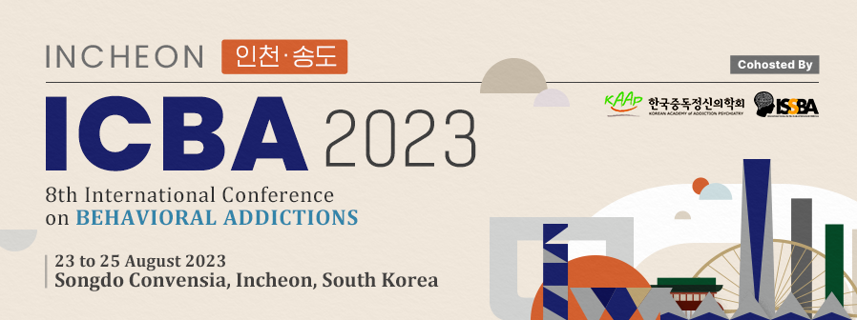




Slide 20
Thank you for listening
Any questions?
sunyoung114@gmail.com
Notes:
Thank you for listening.
If you have any questions, please ask through my e-mail.

